Slide 1
Seminar 3a: Validity
Emily Rose C. Nery, MD
MAE4011: Principles of Measurement
CEMO International Masters Program

Slide 2
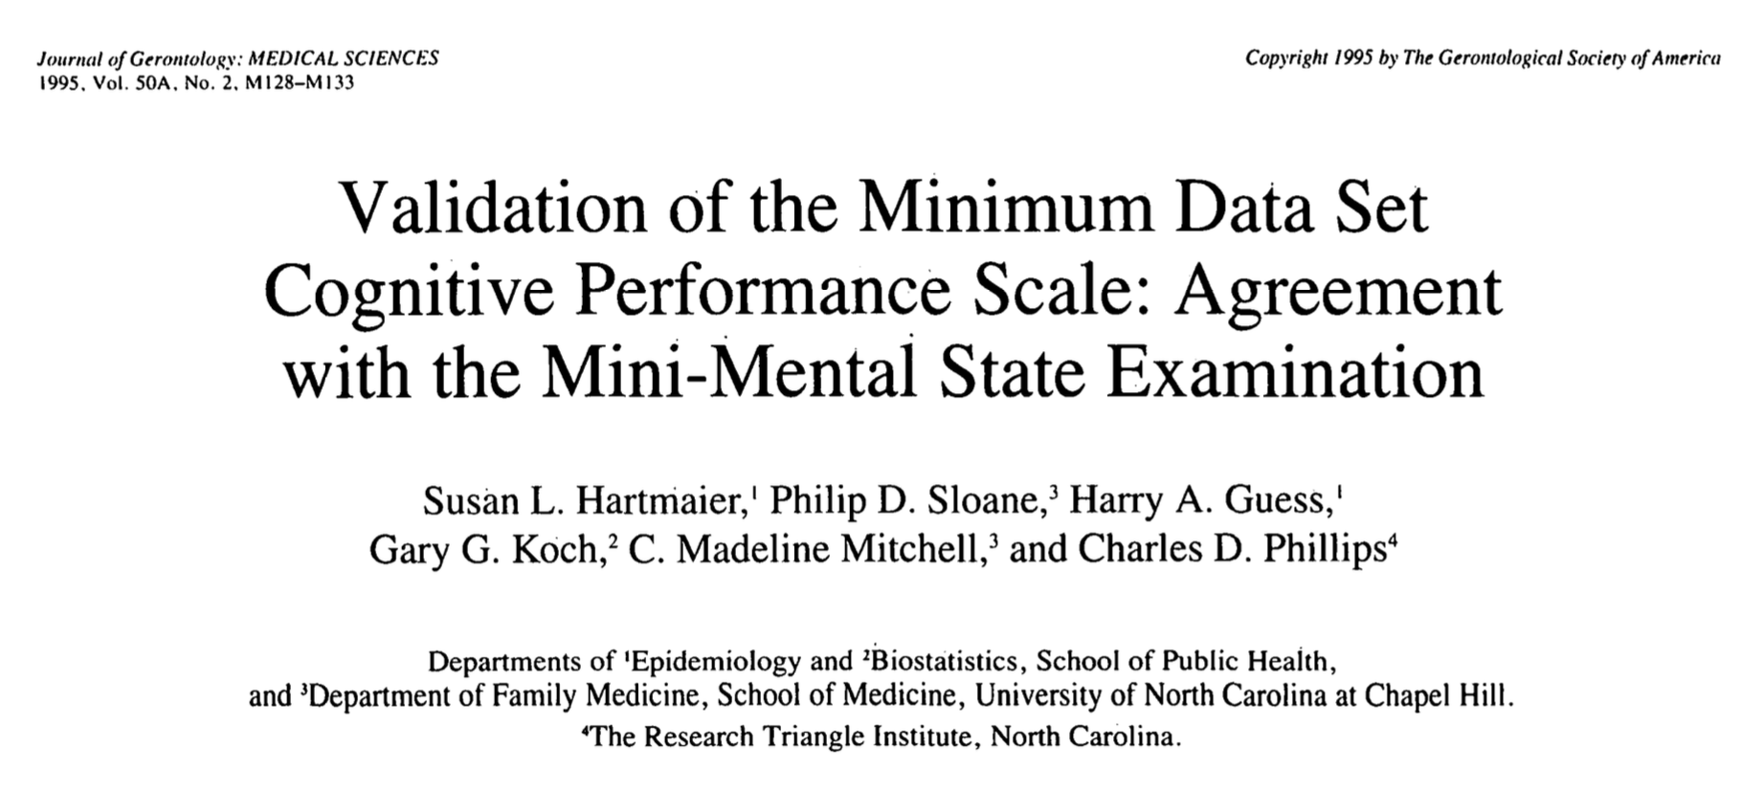

Slide 3
Introduction
Dementia
General term for cognitive decline : memory loss, impaired reasoning and thinking abilities
Many causes: Alzheimer’s, Vascular type, Lewy bodies, Frontotemporal
Alzheimer’s Disease – chronic, progressive, fatal neurologic disease
Alzheimer’s type of dementia : most common, risk factors - increasing age and family history
Residents of nursing homes
Problems with functional status
Physical deterioration, cognitive decline, onset or exacerbation of illness
1987 Omnibus Budget Reconciliation Act in the US
Legislation signed into law by Pres Ronald Reagan
Changed quality assurance systems in the nursing homes – established new standards and revamped inspection and enforcement processes
Compliance by nursing homes required to receive funding and reimbursements from Medicaid and Medicare

Slide 4
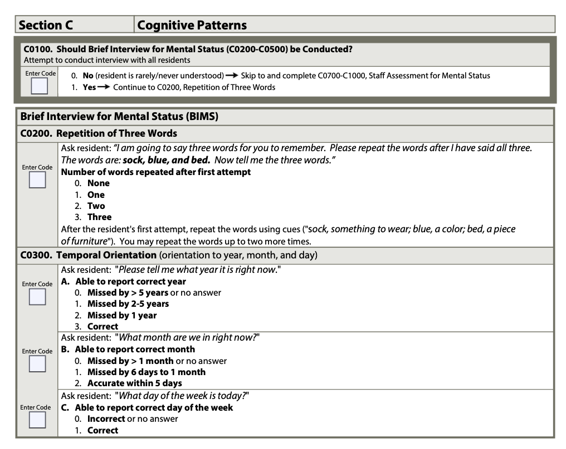
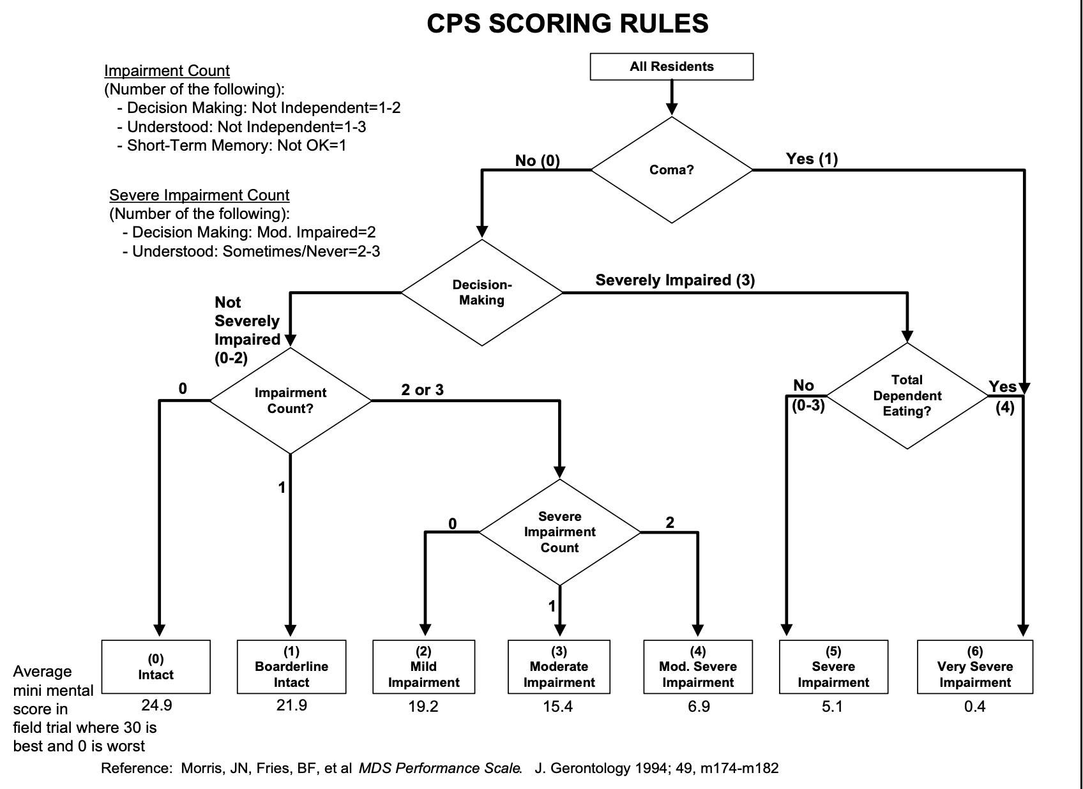
Resident Assessment Instrument (RAI)
Minimum Data Set (MDS)
Care Area Assessment (CAA)
RAI Utilization Guidelines
Minimum Data Set (MDS)
MDS-Cognitive Performance Scale
Morris JN, Hawes C, Murphy K, et al. Resident Assessment Instrument training manual and resource guide. Natick, MA: Eliot Press, 1991.
Morris JN, Fries BE, Mehr DR, et al. MDS Cognitive Performance Scale. J Gerontol Med Sci 1994;49:M174-82
A 21 core set of screening, medical, psychosocial, functional and cognitive status.
Clinical professionals to directly observe and assess the resident’s performance during a specified time period
OBRA requirement : Resident Assessment Instrument (RAI).
RAI : standardized assessment system, consists of three basic components

Slide 6





Study methodology
n = 200
MMSE
CPS
Research Team
*Alzheimer’s Special Care Units

Slide 7
The Tests In-Depth
MDS-Cognitive Performance Scale
Mini-mental State Examination

Slide 8

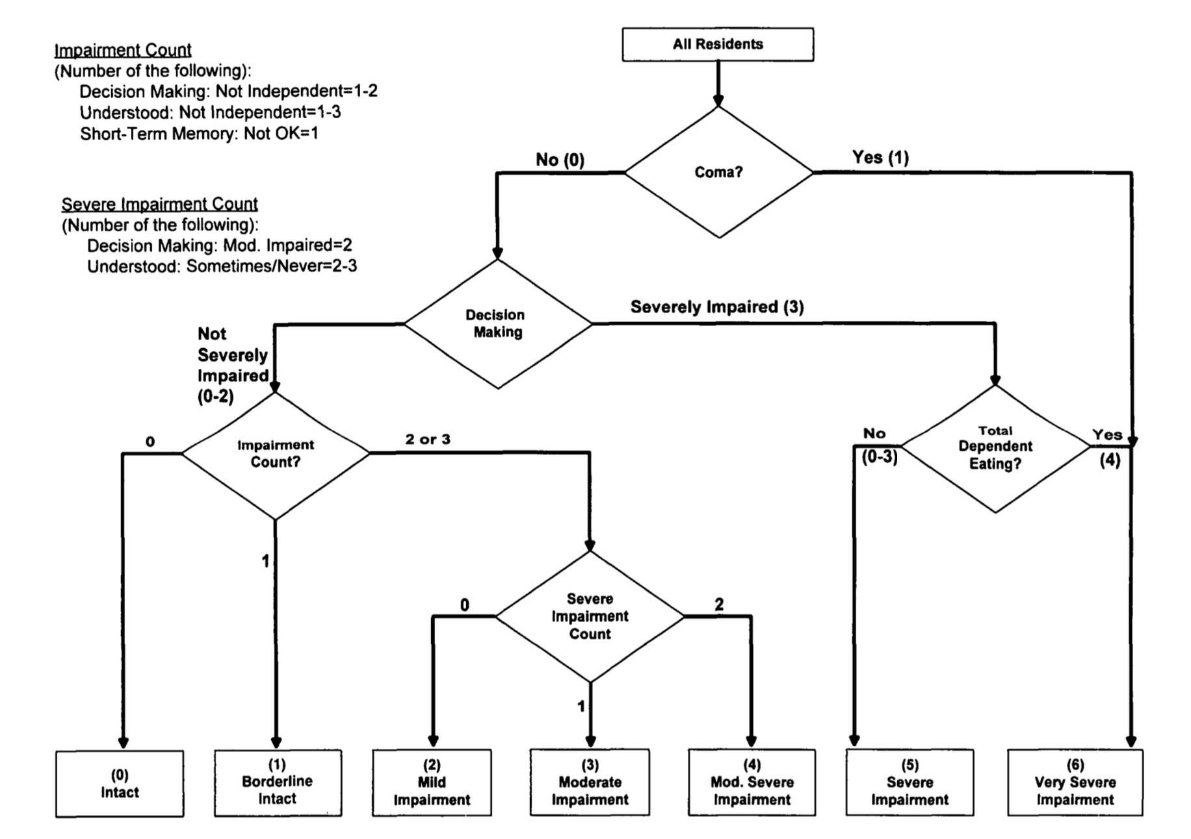
CPS
Comatose?
No = 0 ; Yes = 1
Ability to make decisions about tasks or ADL?
Ind = 0 ; Modified; Mod Imp; Sev Imp= 3
Impairment count?
Short term memory OK?
Ok = 0 ; Not ok = 1
Make self understood?
Yes = 0 ; Usually, Sometimes, Rare = 3
Eating performance?
Ind = 0 ; Supervision, Limited Assistance; Extensive assist; Total dependence = 4
Morris JN, Fries BE, Mehr DR, et al. MDS Cognitive Performance Scale. J Gerontol Med Sci 1994;49:M174-82

Slide 9

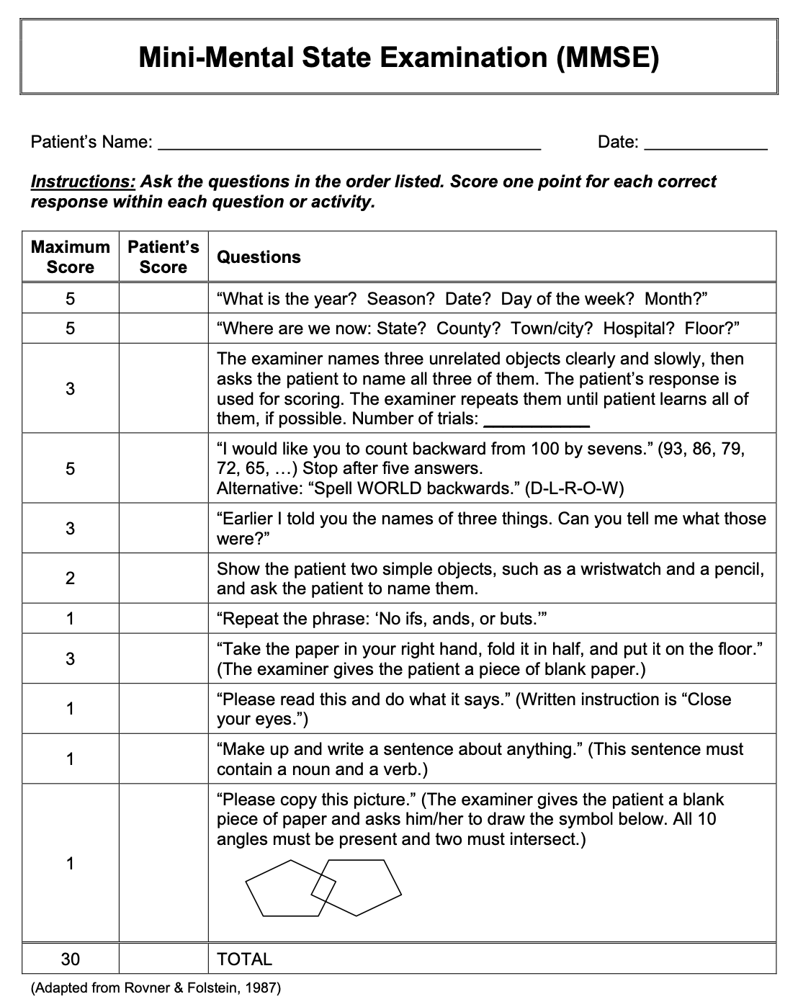
MMSE
Orientation (10 pts)
Registration (3 pts)
Recall (3 pts)
Attention & Calculation (5 pts)
Language (9 pts)
Folstein MJ, Folstein S, McHugh PR. Mini-mental state: a practical method for grading the cognitive state of patients for the clinician. J Psychiatr Res 1975;2:189-98.

Slide 10
Mini Mental Sate Examination (MMSE)
Score | Interpretation
24-30 | No cognitive impairment
18-23 | Mild cognitive impairment
0-17 | Severe cognitive impairment
Cognitive Performance Scale (CPS)
Score | Interpretation
0 | Intact
1 | Borderline intact
2 | Mild impairment
3 | Moderate impairment
4 | Moderate severe impairment
5 | Severe impairment
6 | Very severe impairment
MMSE – Adjusted for Education
Score | Interpretation
*17 | Abnormal for 8th grade education
<23 | Abnormal for high school education
<24 | Abnormal for college education

Slide 11
Cognitive Performance Scale
Mini-Mental State Examination
Developed by: Morris, Fries, 1994
Combines 5 MDS cognitive items
Single, hierarchical rating scale with 7 categories of cognitive impairment
Score: 0 to 6
6 = cognitive impairment
Who administers: nurses, social workers, therapists
Developed by: Folstein, Folstein, 1975
Composed of 11 questions, 5-10mins
”Gold standard” to identify cognitive impairment and deterioration over time
Score: 0 to 30
<24 = cognitive impairment
17 = cut off point ≤ grade 8 education
Who administers: physicians

Slide 12
Evidence category

Slide 13
Evidence based on relations to external variables
Dementia
(Cognitive impairment)
Comatose
Cognitive Performance Scale
Mini-Mental
State Examination
Orientation
Short term memory
Registration
Decision making
Attention & Calculation
Making self understood
ADL Eating performance
Recall
Language

Slide 14
Subcategories of evidence
Convergent evidence
When other tests used to measure the same construct exhibit strong relationships
Study: Spearman correlation coefficient; Kappa coefficients of reproducibility
Test-criterion
How accurate the test score predict the criterion
Concurrent evidence – test-criterion information at the same time
Study: Criterion – dementia (cognitive impairment)
Area under the ROC curve – to test diagnostic accuracy of CPS for intact vs impaired, as defined by MMSE
Validity generalization
Study limitations preclude validity generalization

Slide 15
Study results

Slide 16
Evaluations of validity in the study
Spearman correlation coefficient : r = - 0.863 (p < .001)
Sensitivity and specificity
Kappa coefficients of reproducibility
Measures correct the chance of agreement expected to occur if MMSE and CPS were totally unrelated (0 – 1)
Area under the receiver operating curve
Hanley and McNeil (1982) - single scalar value that measures the overall performance of a binary classifier
The value is within the range (0.5–1.0)
Positive and negative predictive values

Slide 17
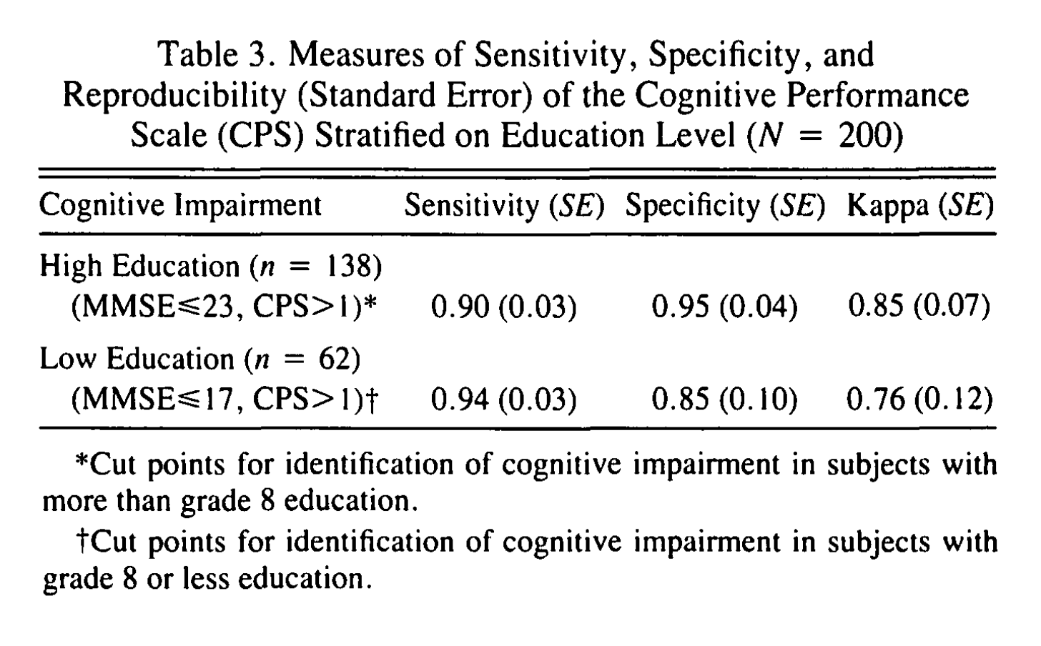
 | Gold standard disease present | Gold standard disease absent
Test positive | True positives | False positives | Total test positives
Test negative | False negatives | True negatives | Total test negatives
 | Total with disease | Total without disease | TOTAL POPULATION
Positive predictive value percentage of patients with a positive test who actually have the disease
Negative predictive value percentage of patients with a negative test who do not have the disease
TP / (TP + FP) | Positive Predicted Value
TN / (FN + TN) | Negative Predicted Value
Sensitivity | Specificity
TP / (TP + FN) | TN / (FP + TN)
Sensitivity ability of the test to classify an individual as “diseased”
Specificity ability of the test to classify an individual as “disease-free”
Hartmaier SL, Sloane PD, Guess HA, Koch GG, Mitchell CM, Phillips CD. Validation of the Minimum Data Set Cognitive Performance Scale: agreement with the Mini-Mental State Examination. J Gerontol A Biol Sci Med Sci. 1995 Mar;50(2):M128-33. doi: 10.1093/gerona/50a.2.m128. PMID: 7874589.

Slide 18
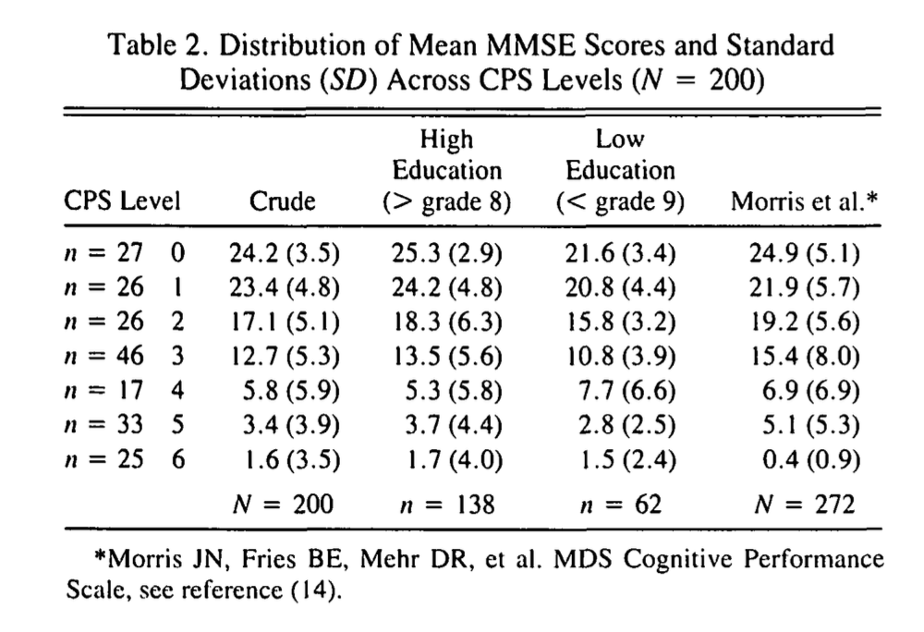
Table shows distribution of the CPS scores and the Mean MMSE scores (SD)
CPS distribution:
53 (26.5%) – INTACT Cognition
89 (44.5%) – Mild to Moderate Impairment
58 (29%) – Severe to Very Severe Impairment
MMSE scores:
Classified respondents using the crude cutoff ( < 24)
Corrected for educational level using the lower cutoff (17) if education level < gr9
Compared with the sample scores in the original Morris paper
Hartmaier SL, Sloane PD, Guess HA, Koch GG, Mitchell CM, Phillips CD. Validation of the Minimum Data Set Cognitive Performance Scale: agreement with the Mini-Mental State Examination. J Gerontol A Biol Sci Med Sci. 1995 Mar;50(2):M128-33. doi: 10.1093/gerona/50a.2.m128. PMID: 7874589.

Slide 19
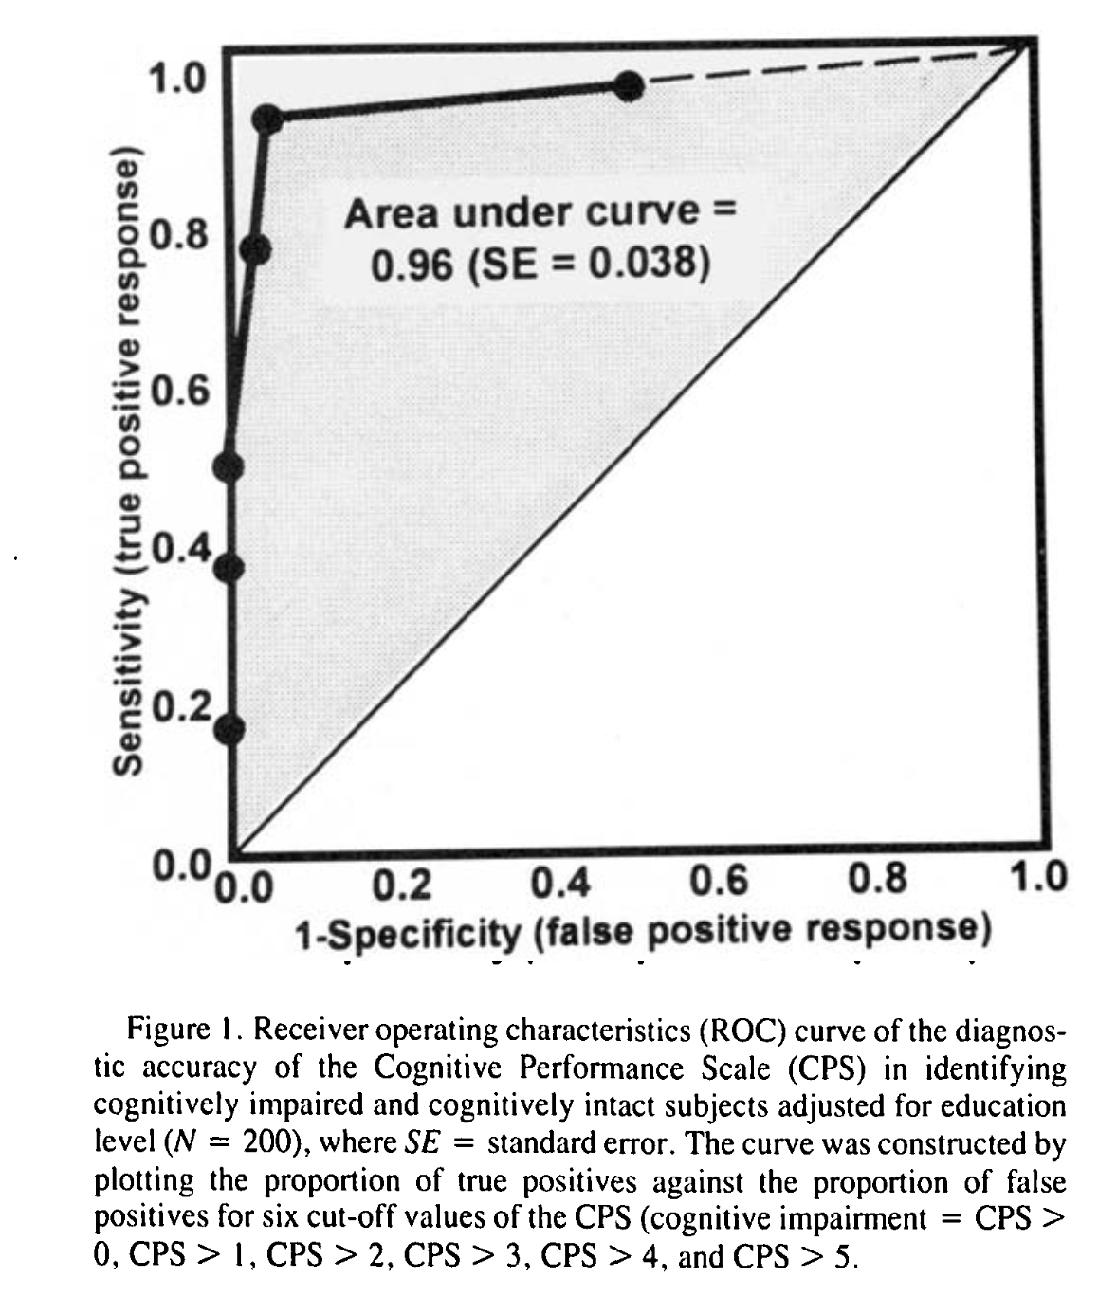
Evaluate the diagnostic accuracy of the CPS to correctly identify cognitive impairment vs intact (as defined by MMSE)
Plotted True positives vs False positives
AUC = 0.96% (95% CI: 0.88, 1.0)
CPS excellent diagnostic accuracy
Hartmaier SL, Sloane PD, Guess HA, Koch GG, Mitchell CM, Phillips CD. Validation of the Minimum Data Set Cognitive Performance Scale: agreement with the Mini-Mental State Examination. J Gerontol A Biol Sci Med Sci. 1995 Mar;50(2):M128-33. doi: 10.1093/gerona/50a.2.m128. PMID: 7874589.

Slide 20
Final words
Small sample population
Respondents sampled by stratified method, not random
MDS data set and the CPS are new at the time of publication
Research nurse (CPS) was trained to follow the recommended protocols described in the official manual
Future large-scale research needed
However, MDS-CPS has potential to screen/monitor cognitive decline in the setting of nursing home and scarcity of resources

Slide 21
References
Hartmaier SL, Sloane PD, Guess HA, Koch GG, Mitchell CM, Phillips CD. Validation of the Minimum Data Set Cognitive Performance Scale: agreement with the Mini-Mental State Examination. J Gerontol A Biol Sci Med Sci. 1995 Mar;50(2):M128-33. doi: 10.1093/gerona/50a.2.m128. PMID: 7874589.
Omnibus Budget Reconciliation Act of 1987. (2020, July 24). In Wikipedia. https://en.wikipedia.org/wiki/Omnibus_Budget_Reconciliation_Act_of_1987
Parikh R, Mathai A, Parikh S, Chandra Sekhar G, Thomas R. Understanding and using sensitivity, specificity and predictive values. Indian J Ophthalmol. 2008 Jan-Feb;56(1):45-50. doi: 10.4103/0301-4738.37595. PMID: 18158403; PMCID: PMC2636062.
Folstein MJ, Folstein S, McHugh PR. Mini-mental state: a practical method for grading the cognitive state of patients for the clinician. J Psychiatr Res 1975;2:189-98.
Morris JN, Fries BE, Mehr DR, et al. MDS Cognitive Performance Scale. J Gerontol Med Sci 1994;49:M174-82
Morris JN, Hawes C, Murphy K, et al. Resident Assessment Instrument training manual and resource guide. Natick, MA: Eliot Press, 1991.
Morris JN, Fries BE, Mehr DR, et al. MDS Cognitive Performance Scale. J Gerontol Med Sci 1994;49:M174-82
Anna N. Rahman, MSW, Robert A. Applebaum, PhD, The Nursing Home Minimum Data Set Assessment Instrument: Manifest Functions and Unintended Consequences—Past, Present, and Future, The Gerontologist, Volume 49, Issue 6, December 2009, Pages 727–735, https://doi.org/10.1093/geront/gnp066
Jessica J. Jalbert, Lori A. Daiello, Kate L. Lapane, Dementia of the Alzheimer Type, Epidemiologic Reviews, Volume 30, Issue 1, 1 November 2008, Pages 15–34, https://doi.org/10.1093/epirev/mxn008

Slide 22
Thank you for listening

